Slide 1


BASAVARAJESWARI GROUP OF INSTITUTION
Ballari Institute of Technology and Management
Department of Artificial Intelligence & Machine Learning
Project Presentation
On
Internal Stack Overflow
Team name: Pyscripters
Presented by:
S Vijay(3BR23AI138)
Md Irfan(3BR23AI086)
P Bharath Yadav(3BR23AI111)
Ravi Kumar Singh(3BR23AI132)
Prof. Surya
Project coordinator

Slide 2
INTERNAL STACK OVERFLOW

Slide 3
CONCEPTS INCLUDED:
Introduction
Objective
Problem statement
Requirements
Existing system
Output
Conclusion

Slide 4
INTRODUCTION
The internal Stack Overflow project aims to create a centralized platform for knowledge sharing and collaboration across teams.
By leveraging the familiar Q&A format, employees can quickly find solutions, contribute expertise, and reduce time spent on repetitive issues.
The project is designed to improve problem-solving efficiency, minimize communication silos, and empower teams to collaborate more effectively.

Slide 5
OBJECTIVE:
Data Management: The system needs to efficiently manage multiple data types (questions, answers, tags, user profiles). An internal stack helps organize these components, ensuring they can be accessed, modified, and displayed effectively.
User Interactions: Features like searching for related questions and upvoting answers rely on maintaining a stack of recent activities or queries, enabling quick access to relevant data.
Performance: Stacking operations can optimize performance by minimizing the time complexity for certain operations, such as retrieving recently interacted ↓ items or maintaining state in user.

Slide 6
PROBLEM STATEMENT:
Current Issues:
Information silos within teams.
Repeated questions and redundancy in problem-solving.
Lack of proper documentation or structured knowledge-sharing tools.
Impact:
Loss of productivity.
Difficulty in accessing past knowledge or solutions.

Slide 7
REQUIREMENTS:
HARDWARE COMPONENTS:
-A computer with at least 1 GHz processor - 1 GB RAM or higher - 100 MB of free disk space
SOFTWARE COMPONENTS:
- Operating System: Windows/Linux/MacOS
-platform- IDLE(python 3.12),pycharm,VS code..etc

Slide 8
EXISTING SYSYTEM
"Existing systems" refers to the current processes, platforms, or technologies in place within an organization or a specific context
Reputation System: Users earn reputation points through upvotes on questions and answers, accepted answers, and can lose points through downvotes.
Badge System: Users can earn badges for various achievements, recognizing their contributions and engagement on the platform.
Voting System: Community members can upvote or downvote questions and answers to indicate quality, helping to surface the best content.
Question and Answer Format: Users can ask questions and provide answers, creating a structured way for knowledge sharing.

Slide 9

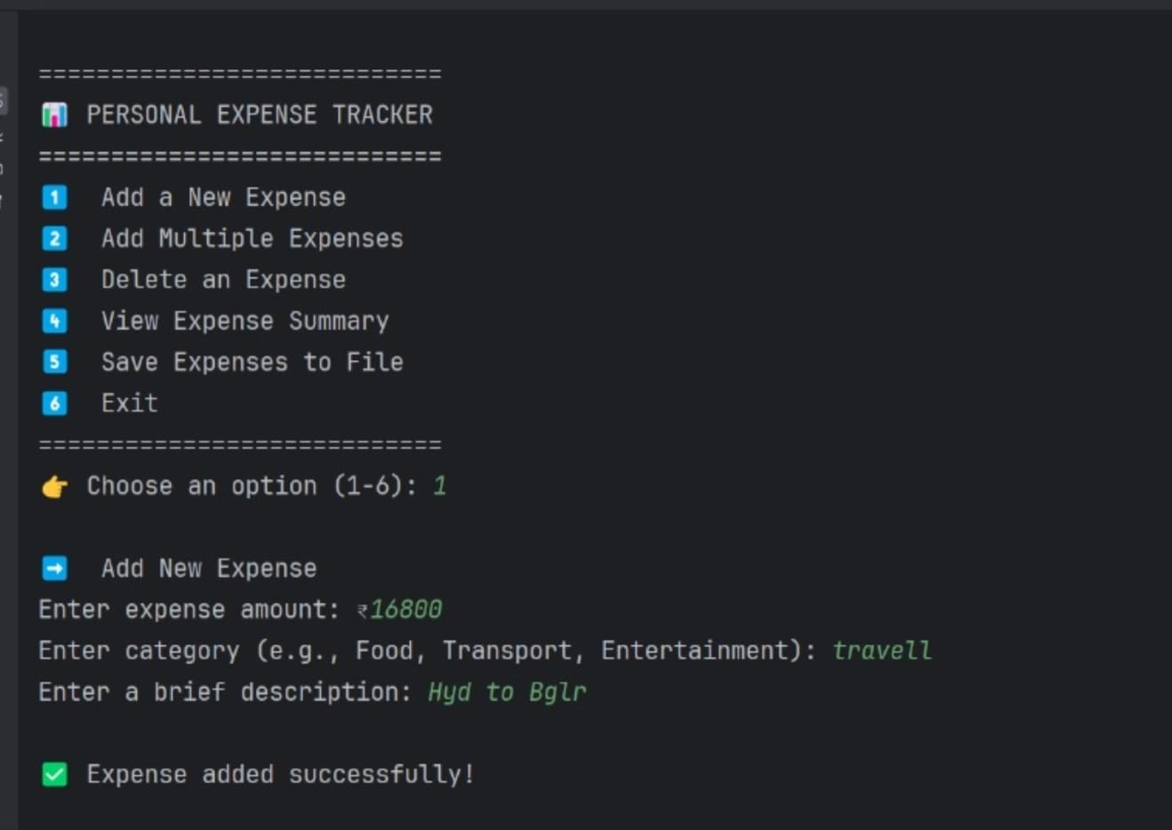
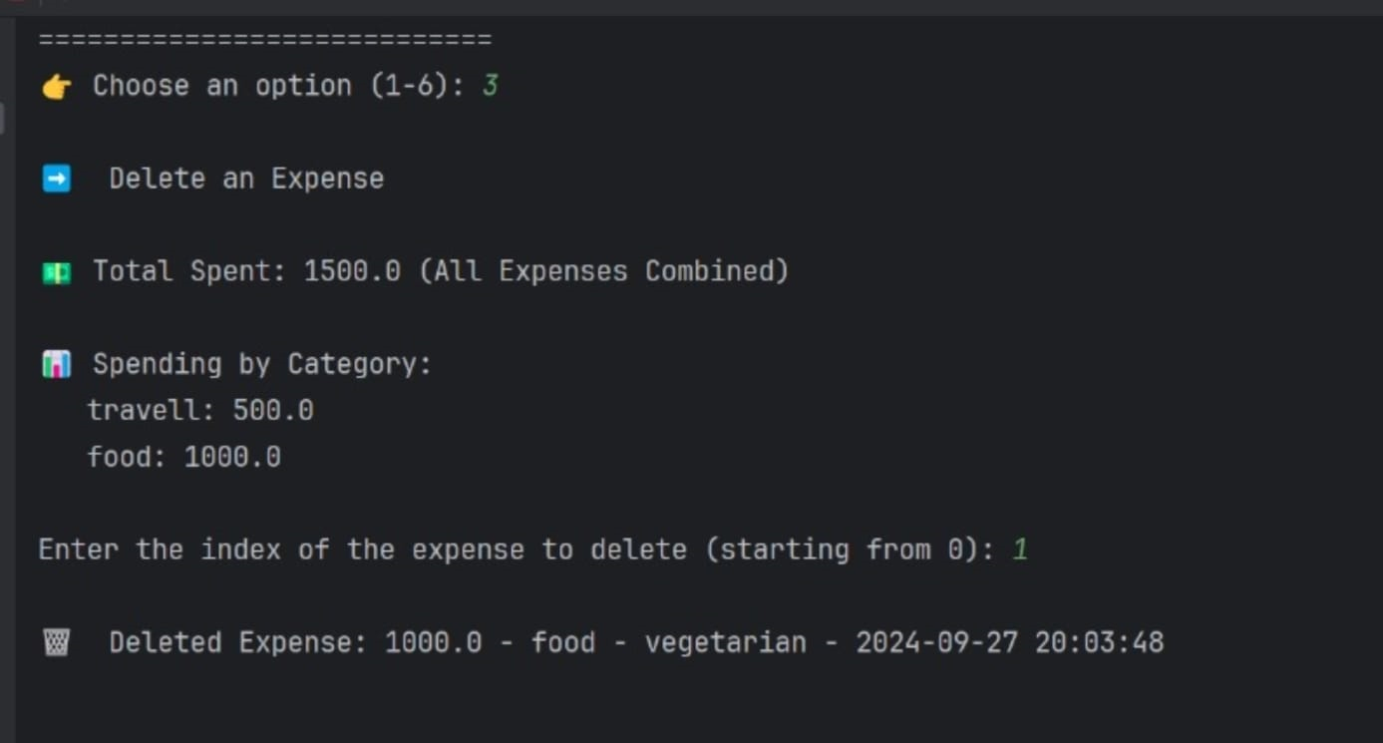
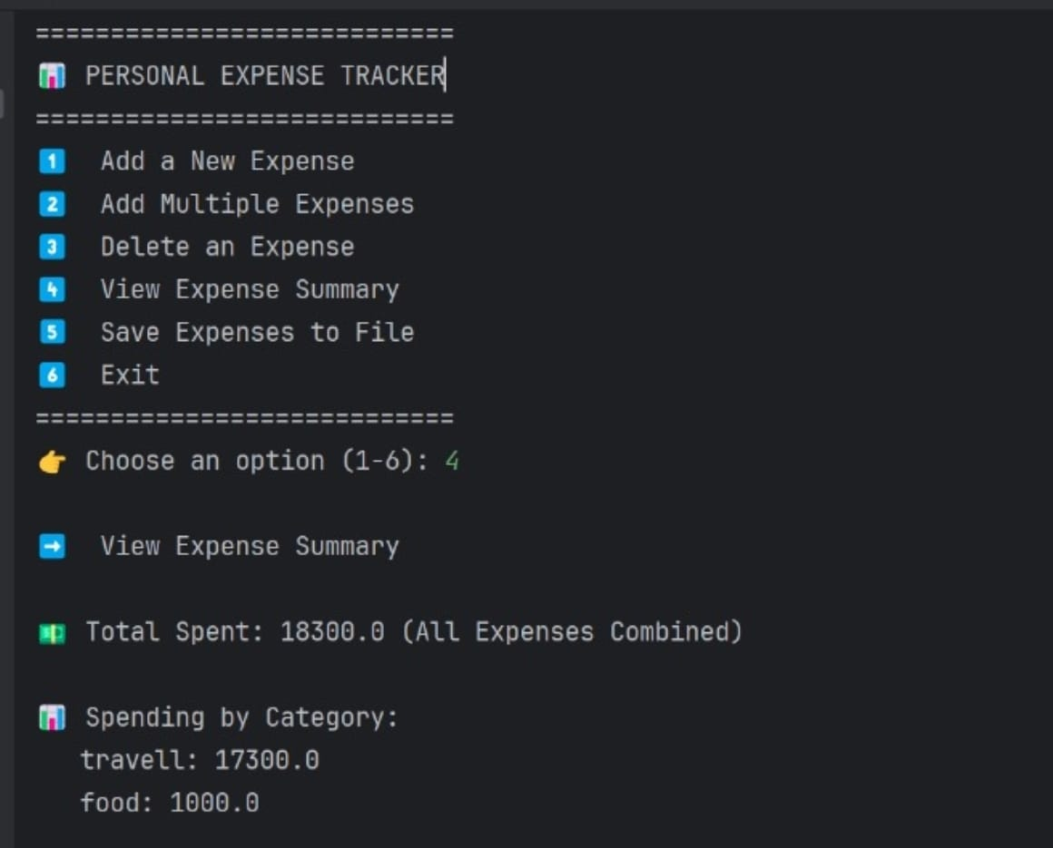
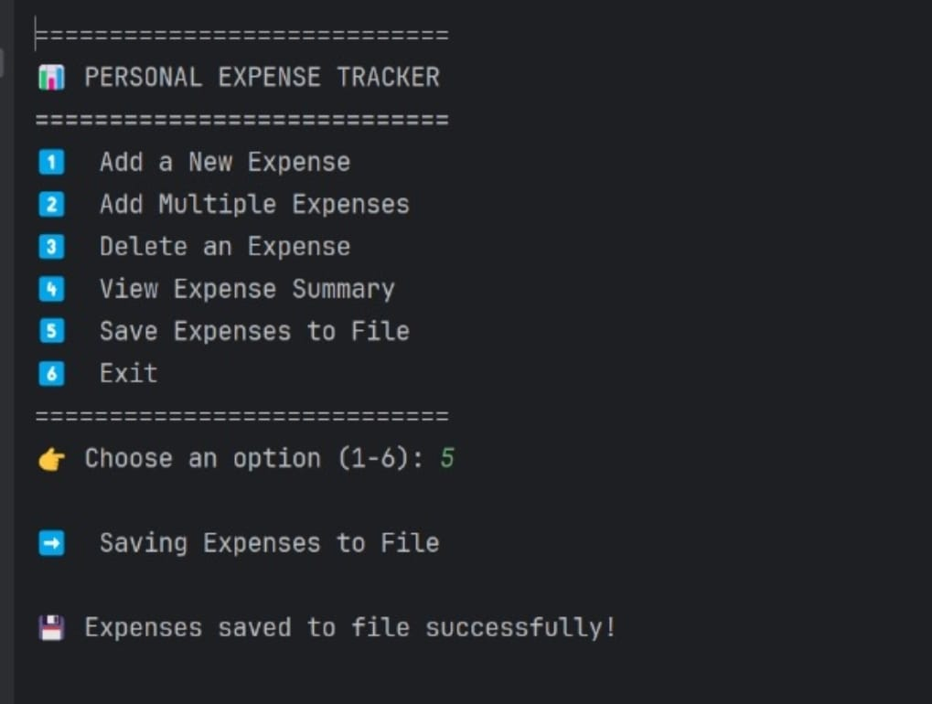
OUTPUT:

Slide 10
CONCLUSION:
Overall, the project is well-structured and functional, but replacing recursion with iteration for adding expenses would enhance its robustness.
The use of recursion in programming, as seen in the
“add_multiple _expenses()” method, can lead to an internal stack overflow when the recursion depth exceeds Python's limit.
This occurs because each recursive call consumes stack space, and if too many calls are made, the stack can overflow, resulting in a Recursion Error

Slide 11


